Slide 1
IETF Hackathon -Comprehensive Evaluation of Multicast Source Routing over IPv6
IETF 118
4–5 November 2023
Prague, Czech Republic
Notes:
Hello everyone, my name is Wu Weihong, and I’m a phd student in Beijing university of posts and telecommunications. My major is about SRv6 and operators. When I was looking for some solutions about the closed-loop traffic control, I noticed IFIT and APN6, and had some interests in them. So we read some documents and developed both a demo for them.

Slide 2
Hackathon Plan
Implement MSR6 BE, MSR6 TE and MSR6 TE with RLB on hardware using the P4 language.
Evaluate the hardware performance of MSR6 based on several P4 switches.
Conduct simulations to evaluate the resource performance of MSR6 and other 5 multicast solutions from a macro perspective based on real network topology.
Documents
https://datatracker.ietf.org/doc/draft-geng-msr6-traffic-engineering/02
https://datatracker.ietf.org/doc/draft-geng-msr6-rlb-segment/01
https://datatracker.ietf.org/doc/draft-chen-pim-srv6-p2mp-path/
https://datatracker.ietf.org/doc/draft-chen-pim-mrh6/

Slide 3
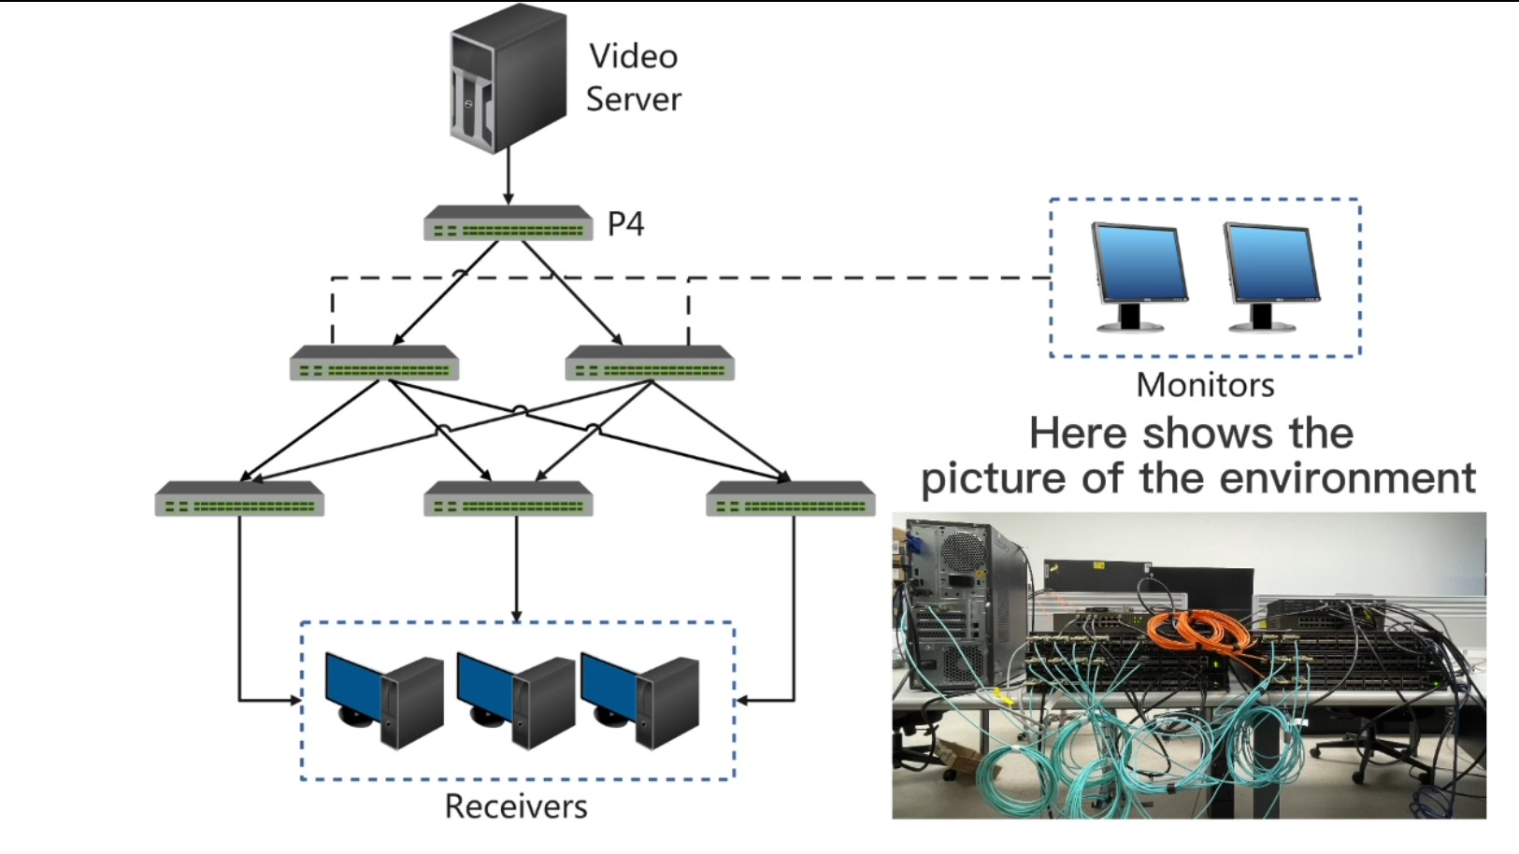
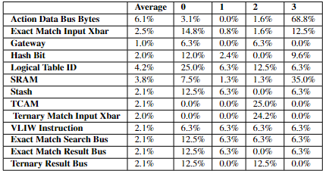
HARDWARE-BASED EVALUATION
Multi-node testing topology was constructed using 6 P4 switches as the ingress, transit, and egress nodes in the MSR6 domain.
The data to be measured are hardware resource usage, process delay and stability.
Resource Occupancy of MSR6 TE

Slide 4
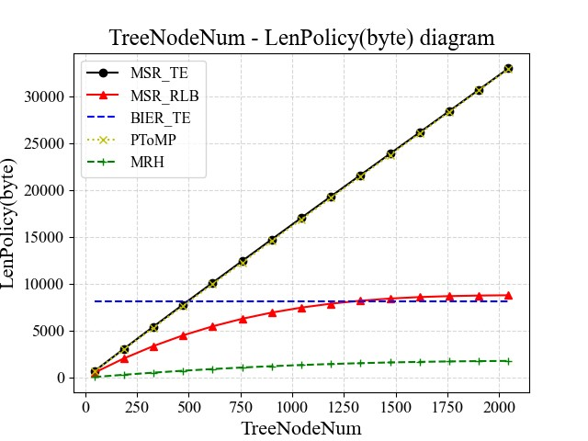
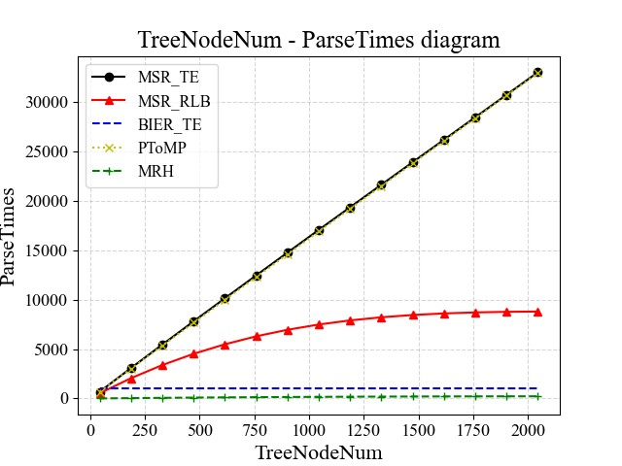
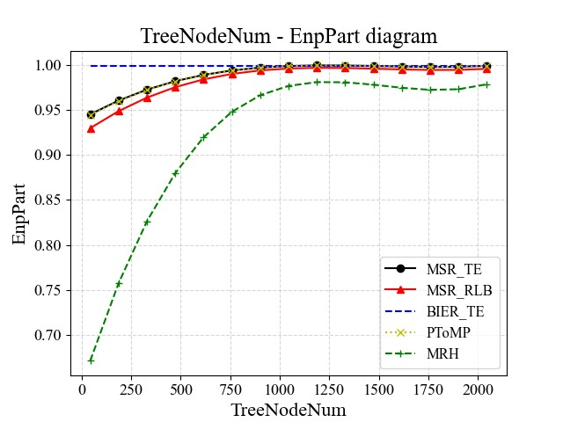
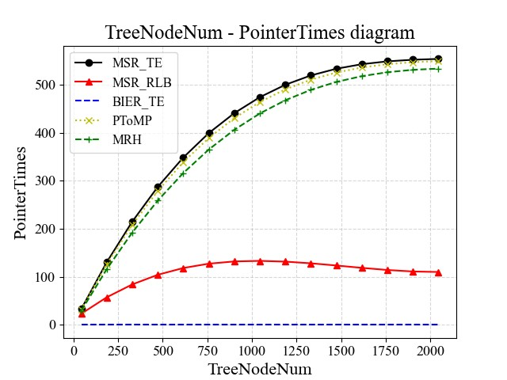
SOFTWARE-BASED EVALUATION
We conducted macro-mathematical simulations on five multicast TE schemes.
We evaluated these five schemes from the perspectives of multicast Policy Length, Parsing Times, Feasibility of Compression, and Complexity of the Pointer-processing in data center network topology scenarios and randomly generated network topology scenarios, respectively.

Slide 5
Conclusions
Hardware-based evaluation:
We tested the MSR6 BE and MSR6 TE schemes and proved that the MSR6 scheme prototype can work in the experimental environment.
Software-based evaluation:
Small multicast business tree size (less than 1/5 of the total number of topology nodes) | all multicast source routing schemes | have significant advantages compared to the BIER-TE scheme.
Relatively large multicast business tree size | MSR6 TE with RLB | superior to other MSR, taking into account encapsulation length and parsing times.
 | MSR6 PToMP | is better for situations where downstream nodes are large and congested.
delay test | MSR6-related actions can achieve a delay similar to normal IPv6 forwarding actions.
stability test | The traffic path switching in MSR6 TE will not affect the continuity of data packets.

Slide 6
Wrap Up
Team members:
Weihong Wu (wuweihong@bupt.edu.cn / wwh_bupt@foxmail.com)
Yuxin Jiang (jyxin@bupt.edu.cn)
Jiang Liu (liujiang@bupt.edu.cn)
Yunyi Tang (tangyunyi0708@bupt.edu.cn)
Pei Anbang(anbangpei@bupt.edu.cn)
Notes:
Finally, if you have some interests or puzzles about the demo or any others, just contact us.
So, that’s all, thanks for listening. And hope to see u again.

